Slide 1
The Effect of National Measures of Wellbeing on Covid 19 Vaccination Progress
A Data Analysis Project by: Andrew Bly, Jake Burns & Zachary Owen

Slide 2
We expect to find a significant correlation between the rate of successful vaccinations and measures of National Well-being
What is the relationship between fully vaccinated people and economic wellbeing?
What is the relationship between fully vaccinated people and population?
What is the relationship between fully vaccinated people and the nature of health expenditure within that country?

Slide 3
What data did we need?
Kaggle CSV of world vaccination progress cribbed from the Our World in Data Github Repository
Measures of Wellbeing
Economic
Populace
Educational
Health
Pulled from the World Bank API

Slide 4
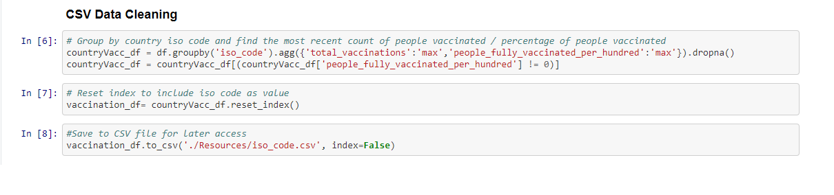
Members of each population fully vaccinated per 100
A CSV was pulled containing data cribbed from the Our World in Data Github Repository
The data was grouped by ISO Code, and aggregated by the Total Vaccinations and People Fully Vaccinated Per Hundred
The data of any countries that did not have any data in the People Fully Vaccinated Per Hundred column was dropped

Slide 5
Data from the World Bank API
Columns were added to the data frame for each variable being analyzed.
A pair of nested for loops were run to cycle through each of the variables and then request the necessary data from the World Bank API
The data was then printed into the data frame
While other measures, such as poverty rate and educational factors, were desirable, four major factors ended up being used
GDP
Total Population
Population Density
Percentage of Health Expenditure in the Private Sector

Slide 6
Insights and Problems
Before Cleaning Gibraltar was most vaccinated
Unable to use several measures that we had hoped due to lack of data
Ended up using 2018 data so as to get the widest array of data points

Slide 7
Steps taken during data analysis

Slide 8
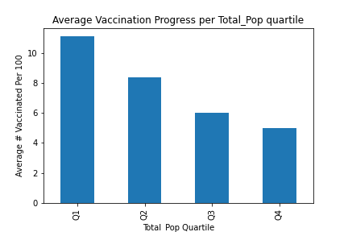
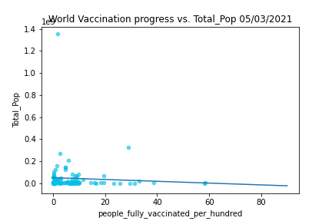
The first variable to be analyzed was the Vaccination Progress compared to the Total Population. While first glance would suggest that the smaller the population the higher the rate of vaccination, this does not hold to be true
This data failed to reject the null hypothesis, thus there is no statistical difference between the data in the different quartiles.

Slide 9
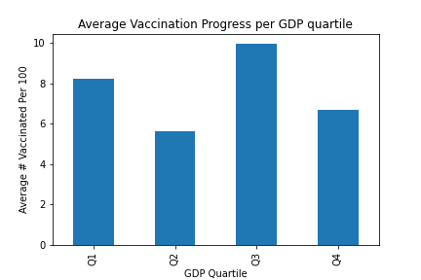
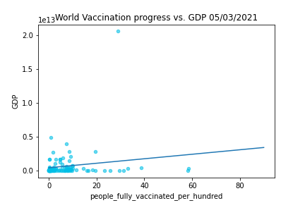
The next variable to be analyzed was the Vaccination Progress compared to the GDP. While there was a higher correlation with these variables, it was still not statistically significant.
This data failed to reject the null hypothesis, thus there is no statistical difference between the data in the different quartiles.

Slide 10
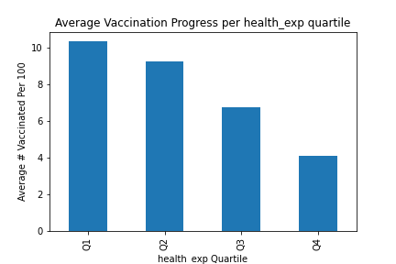
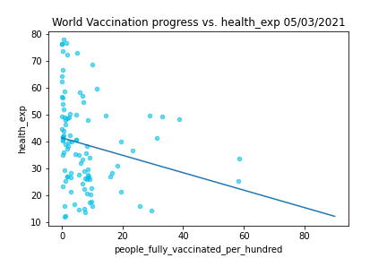
The next variable to be analyzed was the Vaccination Progress compared to the Percent of Health Expenditure from the Private Sector. This was a very interesting set of data as it suggested that as the percentage of health expenditure in the private sector goes down, the rate of vaccinations go up. This suggests that public healthcare increases the rate of vaccinations.
This data failed to reject the null hypothesis, thus there is no statistical difference between the data in the different quartiles.

Slide 11
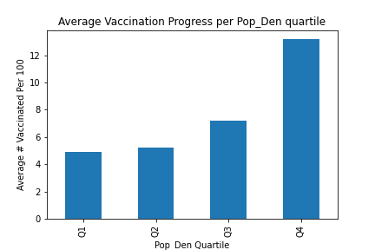
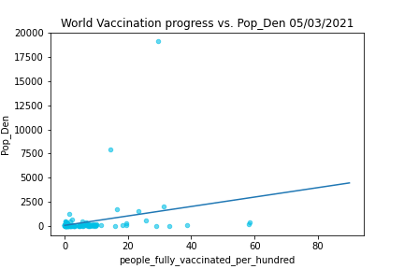
The next variable to be analyzed was the Vaccination Progress compared to the Population Density. This was the dataset with the highest statistical correlation.
This data rejected the null hypothesis, suggesting that there is a statistical difference between the quartiles.

Slide 12
Discuss Findings
GDP not as impactful as initially expected
Population Density had highest correlation
Private Healthcare Expenditure

Slide 13
Post-Mortem
Time difficulty with the reporting of data
With more time use the newly incoming census data to look at poverty rate as a factor

Slide 14
Questions?

